Slide 1

Thynk Unlimited
The effect of Cosmological parameters on inferring the Chirp Mass from Gravitational Wave Data
Read More
Raghad Rashed
Supervised by: Dr. Walid Azzam
University of Bahrain, Department of Physics
December 2024
1

Slide 2

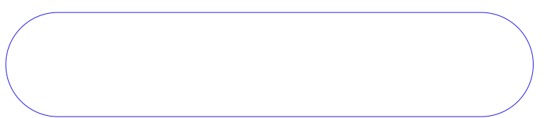
01
02
03
Introduction: Brief history, Background
Theory: Inntroduction to GWs Data analysis
Aim and Methodology
04
05
Results
Discussions and conclusions
Agenda
2

Slide 3
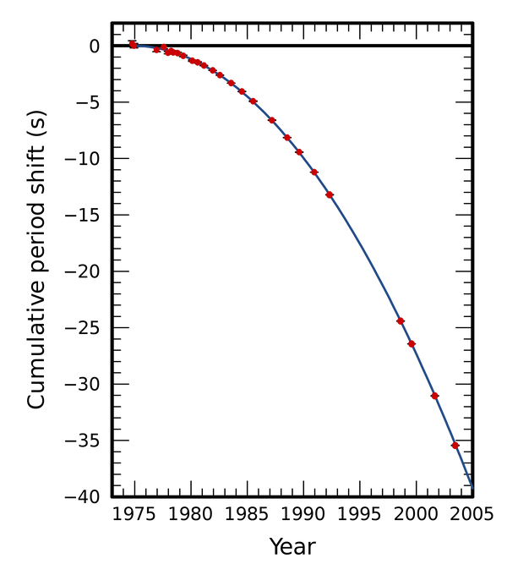
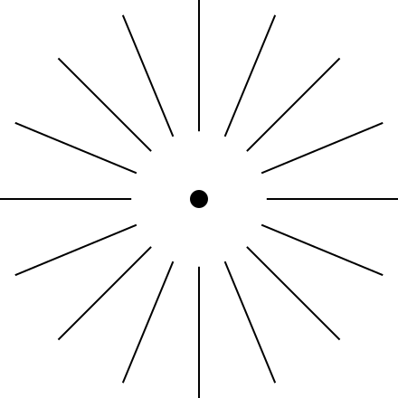
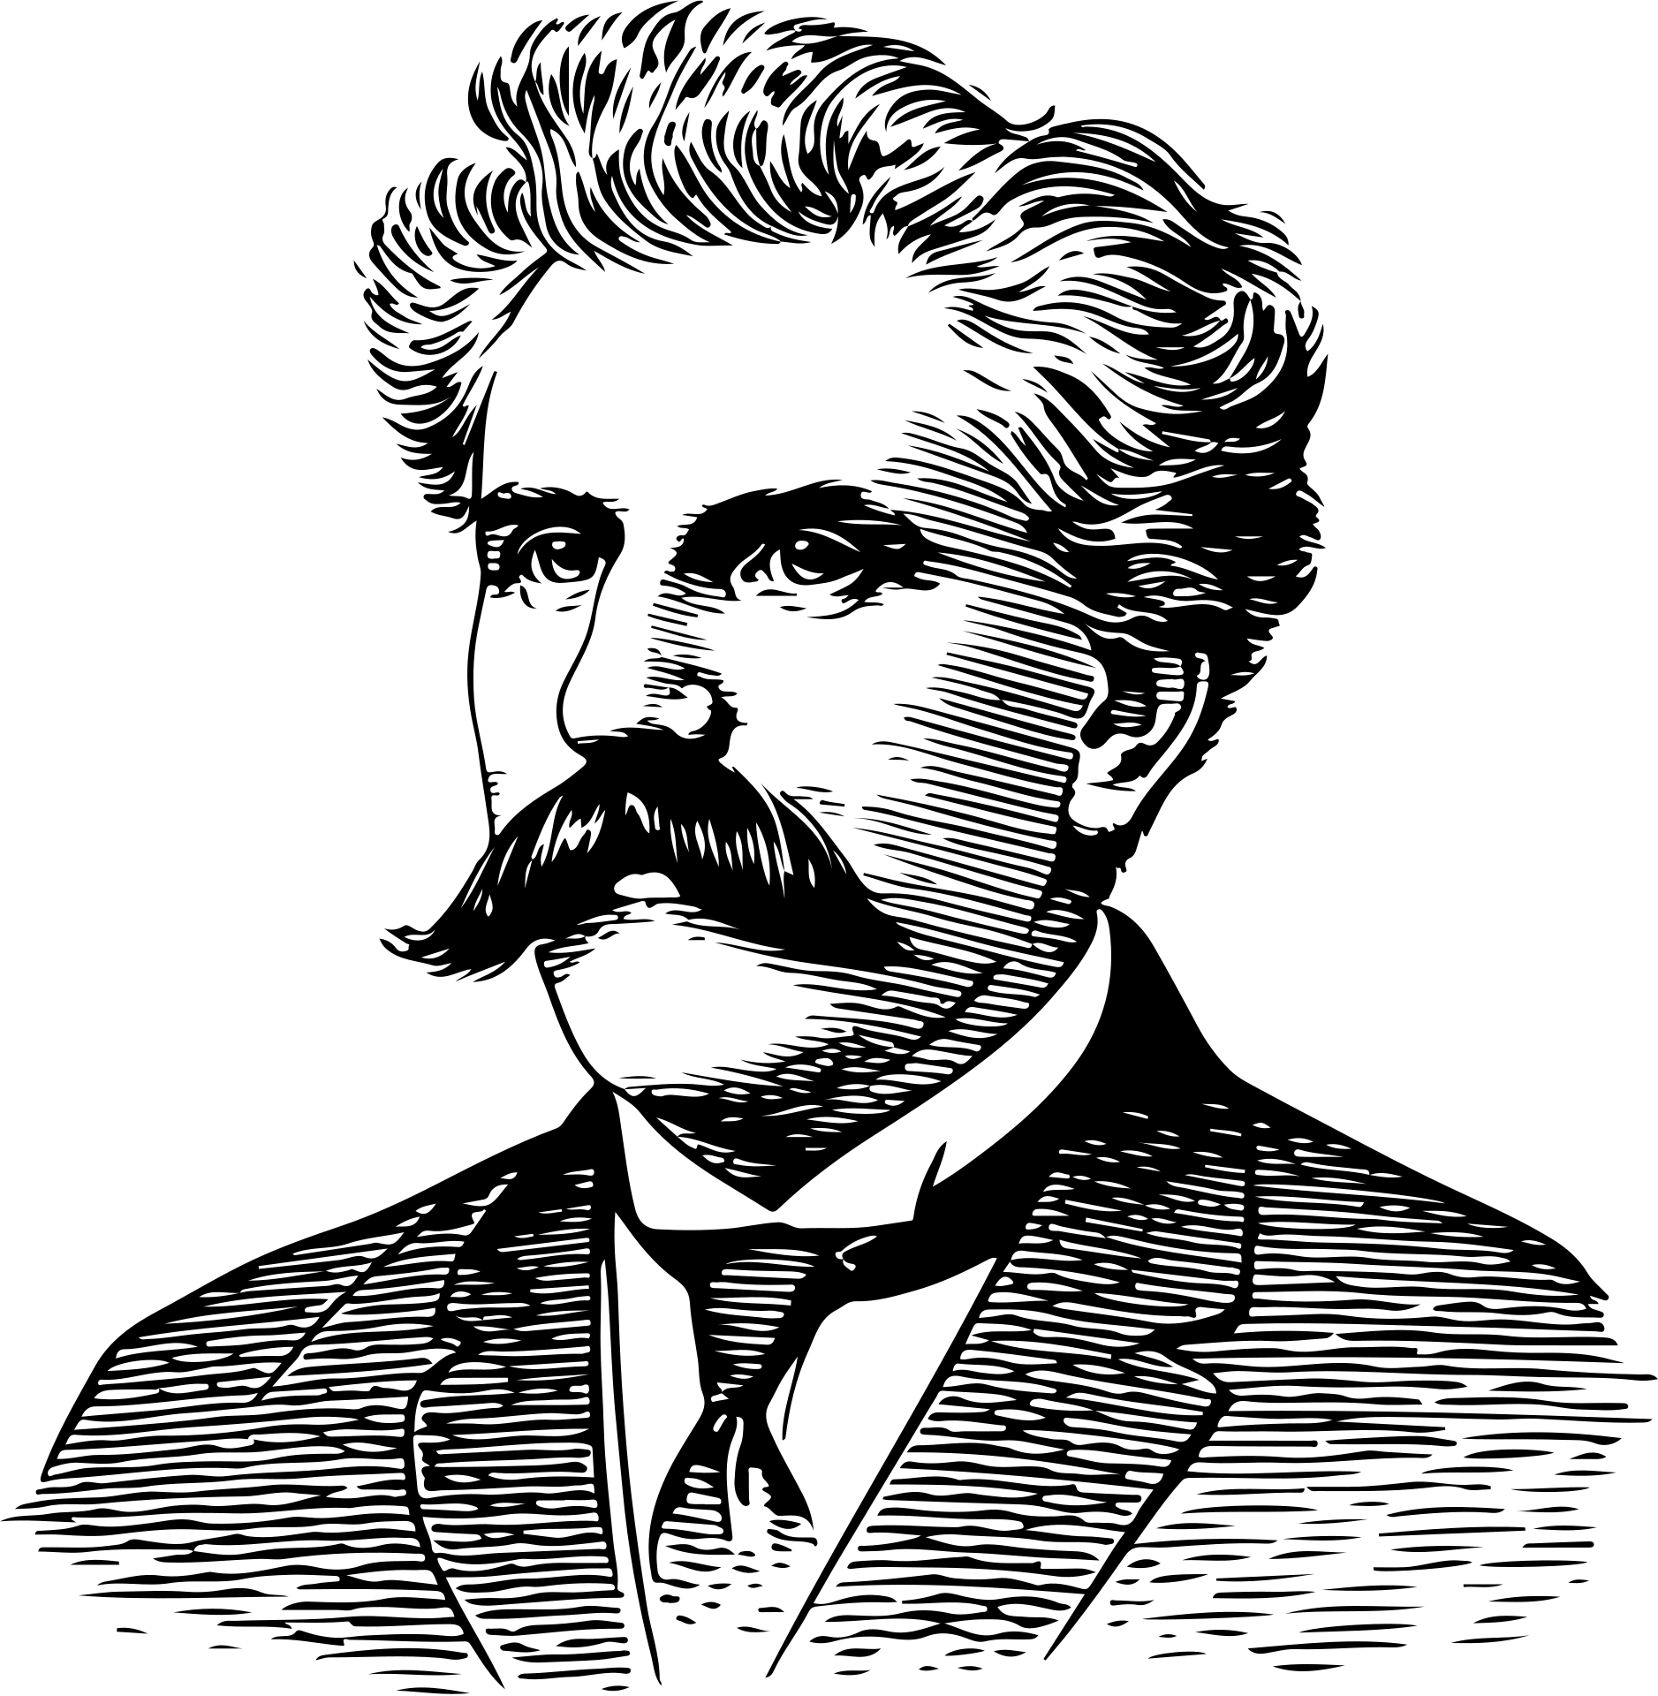
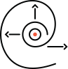
100 YEARS OF HUNTING THE GRAVITY WAVES
1915
Gravity is a manifestation of the massive objects present in the space curvature.
1974,
Taylor-Russell Hulse announced the first indirect detection of GWs, evidenced by their radiation effects on a binary pulsar system
14 -9- 2015.
The laser interferometer gravitational wave observatory (LIGO) announced the first direct detection of binary black holes sysem.
(Einstein, 1915).
(Taylor et al, 1979)
(B. P. Abbott et al., 2016).
3

Slide 4
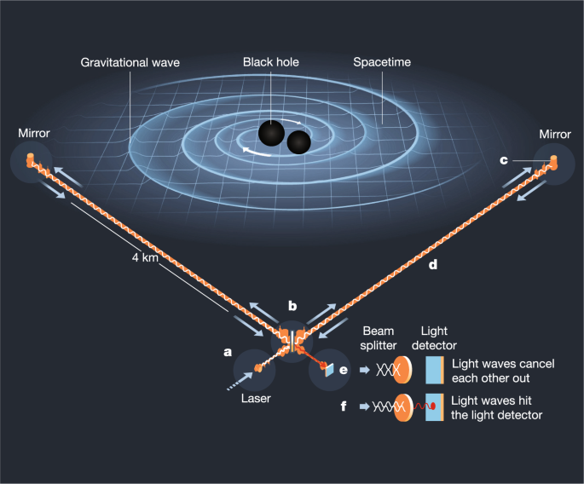
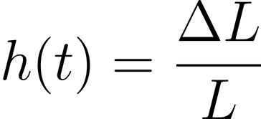
How it was detected?
The challenge of detecting the GWs was to invent a tool that would
measure a quantity change by about 10^−21, which is less than the diameter of a proton.
4

Slide 5
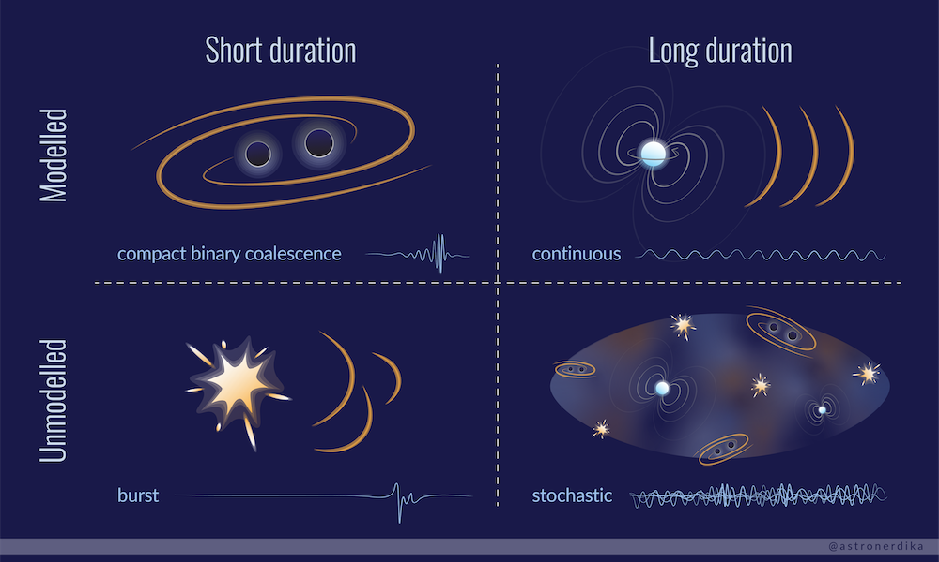
Source and Type

Slide 6

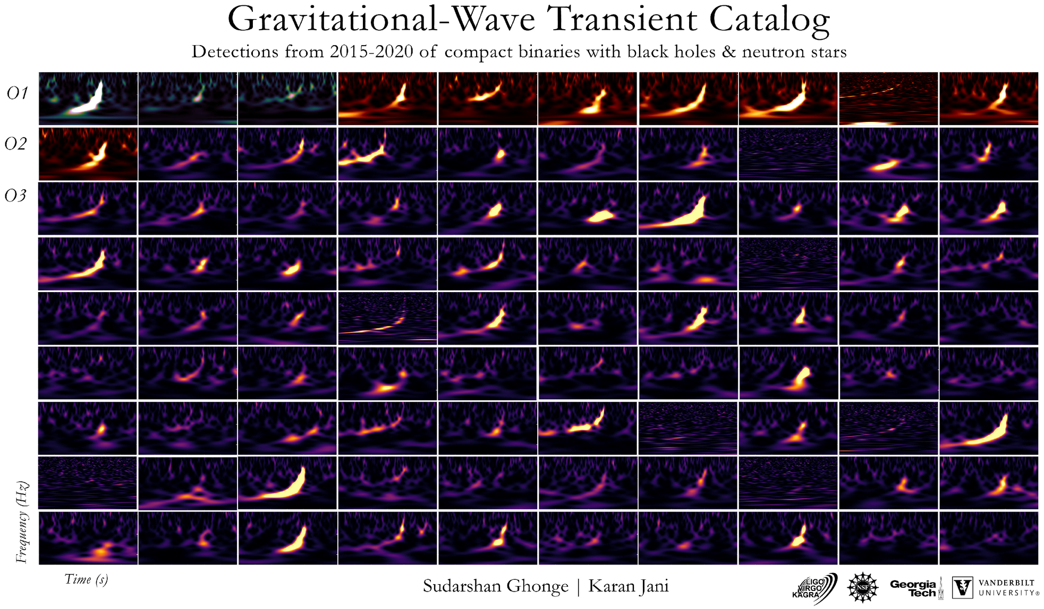
Thynk Unlimited
Page 03
5
Notes:
5

Slide 7
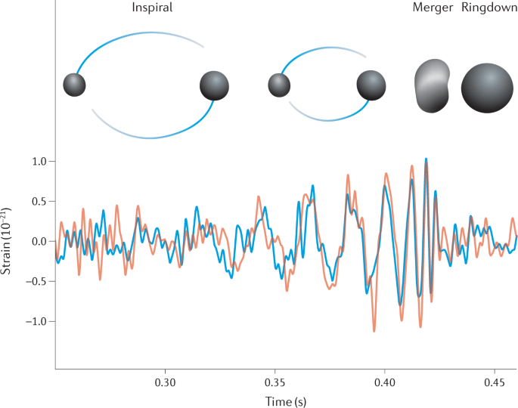
General Case for the compact binary coalescence
Figure 1.4: The strain data of GW190814 for the two interferometers. As the orbit of the rotating binary system shrinks (Inspiral phase), the objects get closer, and the frequency and energy increase until they collide (Merging phase). The system forms either a black hole or neutron star final object, releasing energy differences as GWs (Bailes et al., 2021)
6

Slide 8

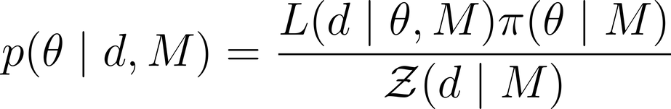
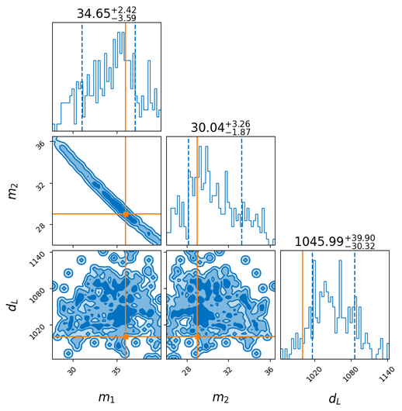
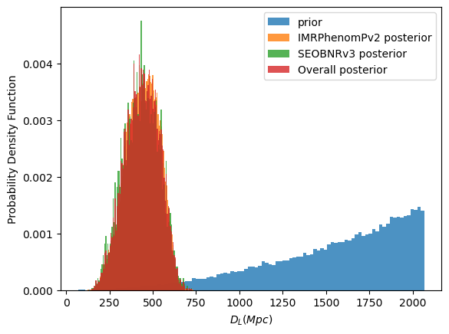
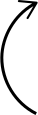
How can we infer the mass?
Thynk Unlimited
Theory
The main method for dealing with uncertainty in the GW source parameters is achieved by the Bayesian statistic.
We can ensure
Questions like how massive the objects are?
How fast they are spinning?
How far are they?
For model M, let d be the strain data, θ is the set of 15 parameters that we want to estimate.
The prior distribution π(θ | M) ,
The posterior distribution p(θ | d,M) via the evidence Z(d | M) of the data
(Gair, 2019).
How do we intreprate the data?
Statistic:
Kernel Density function
for “skewed” distributions

Slide 9
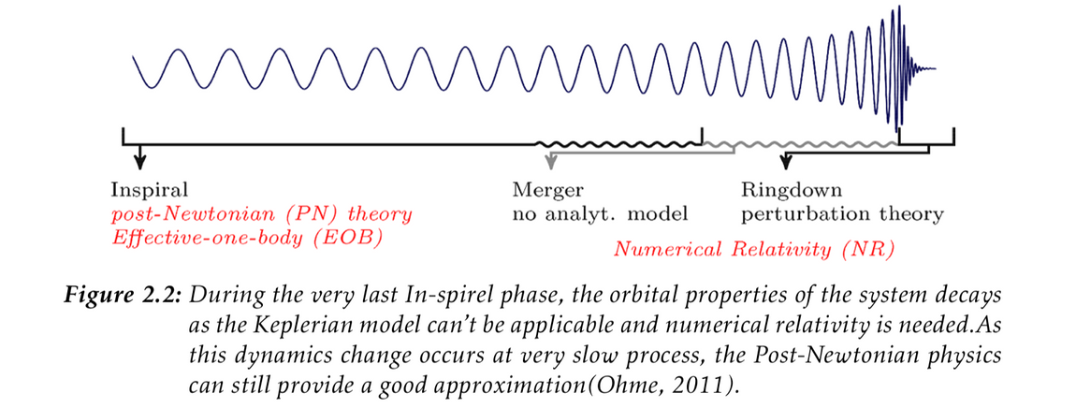

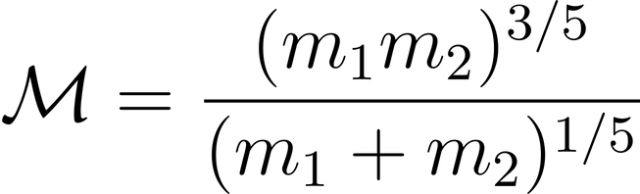
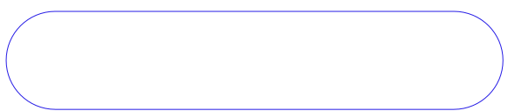
Thynk Unlimited
Newtonian Framework:
Theory
If the binary system is non-compact and closer to the circular orbit,
Newtonian regime is valid, and can describe the chirp mass as the “effect mass”
in term of the masses as:

Slide 10
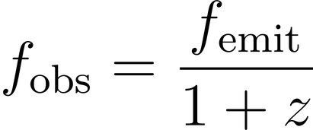
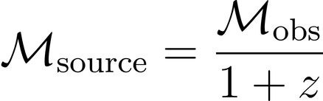
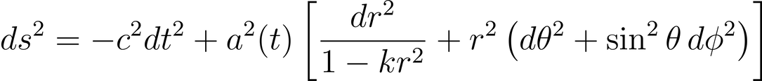
Detector frame - Source frame
Theory
The Fried mann–Robertson–Walkermetric(FRW):
The universe is "isotropic and homogeneous" , the "metric" is the main quantity that can describe the geometry of the universe on the Gpc scale
(Maggiore, 2018):
The observed frequency is redshifted by the factor 1+z,
The GWs signales apppears to have “lower frequency”
The chirp directed inferred from the data is not the “source mass”
we need to correct it !
7

Slide 11
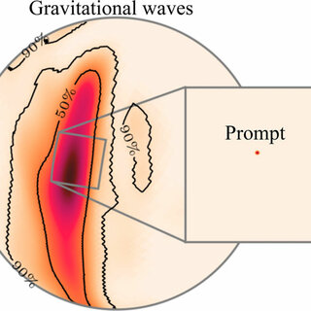
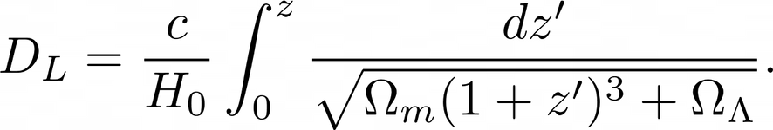
Thynk Unlimited
How do we actually get the redshift
Theory
Input: DL
Assumed
Cosmology
A cosmology model:
The paramaers:
H0
Ωm
ΩΛ
8

Slide 12
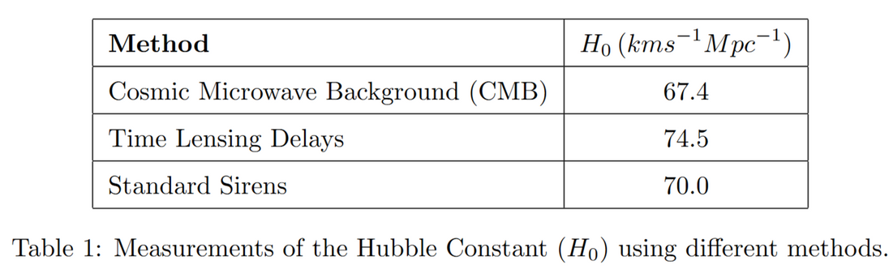
Methodology
Thynk Unlimited
Aim:
How does the discrepancy in Hubble constant affect the chirp mass estimation?
The selected events are:
GW150914, GW170814, GW190828, GW200112, GW200129, GW200224, and GW200311,
All the events are attributed to binary black holes (BBH).
Systems with almost equal masses (i.e., mass ratio in the range was choosen
0.8 ≤ q ≤ 1,
so using the Newtonian mechanism framework is justified.
A discrepancy between the values of H0​ measured by different experimental techniques.
( around 4σ).
9
Notes:
Change the experimental discrepancy

Slide 13
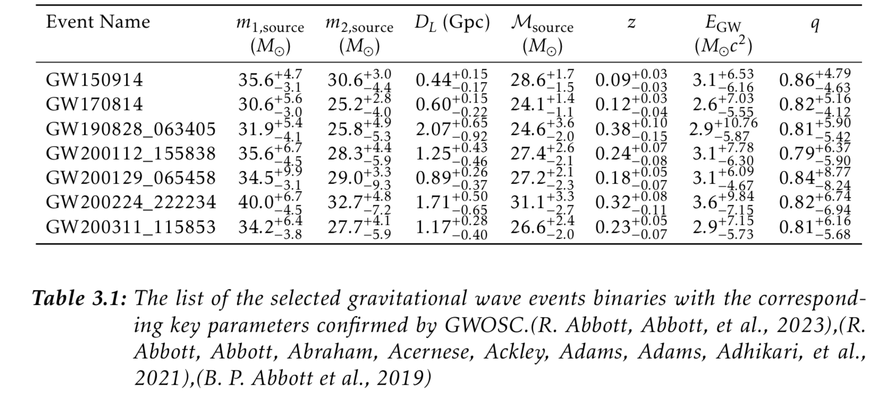
Methodology
Data Sampling
10

Slide 14
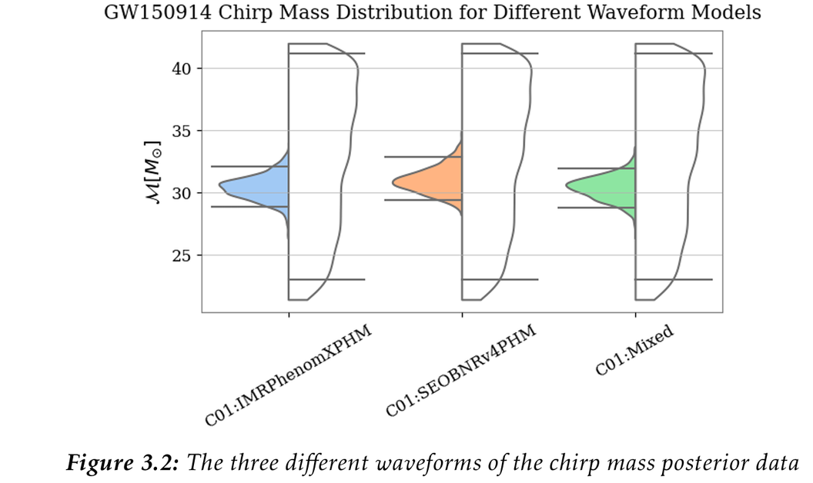
Methodology
Data Sampling: Python
A computational approach using Python programming language was employed to compute the
1-The redshift
2-The chirp mass of the detector frame
3-The corrected chirp
The waveform model "C01:Mixed" is chosen for all the samples due to its comprehensive posterior parameter distribution.
h5py library used to
access and load the data
11

Slide 15
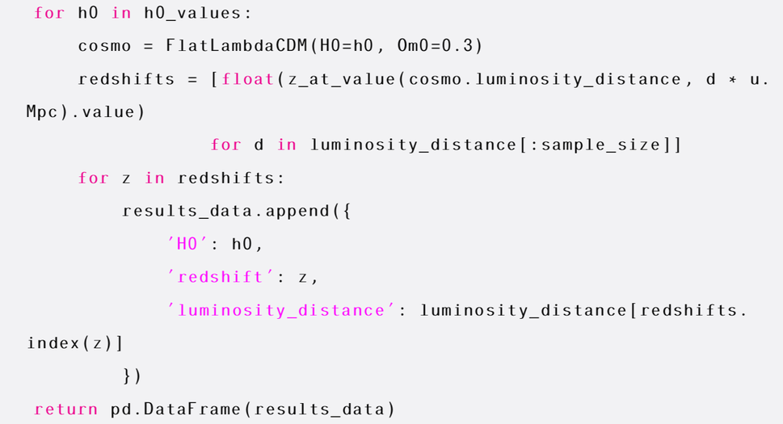
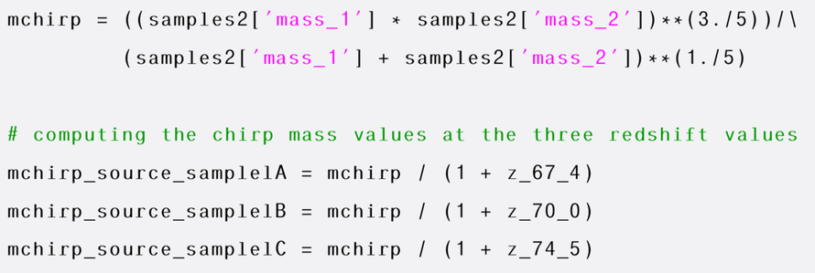
Methodology
Main algorithm
Chirp Mass Calculation:
Using the detector-frame masses from the published data of each event,
The detector-frame chirp mass was estimated using the chirp mass equation.
The source-frame chirp mass was then computed by dividing the detector-frame chirp mass by (1+z) for each redshift value
Redshift Estimation:
By assuming the cosmology
, the luminosity distance values from each event posterior samples were used to estimate the redshift posterior for the three H0 values.
12

Slide 16
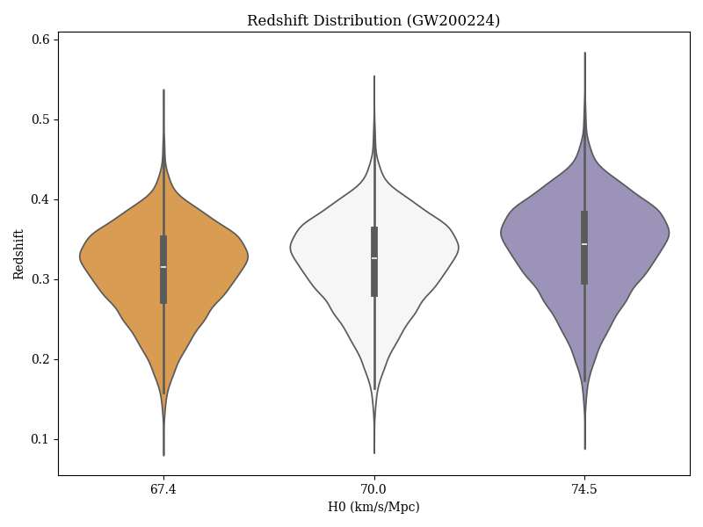
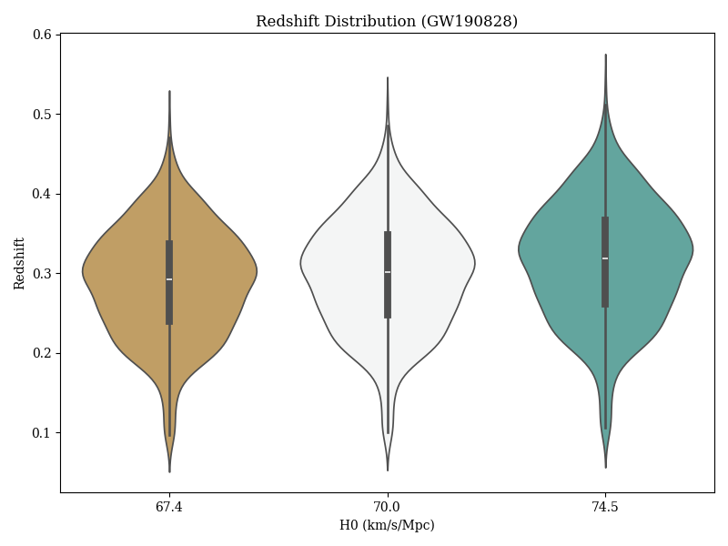
Results
The redshift
The larger deviation in the redshift values corresponds to the highest redshift events (GW200224_222234, GW190828_063405).
where objects occurring at higher redshifts are more likely to be affected by cosmology and the expansion rate of the universe
13

Slide 17
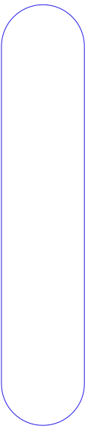
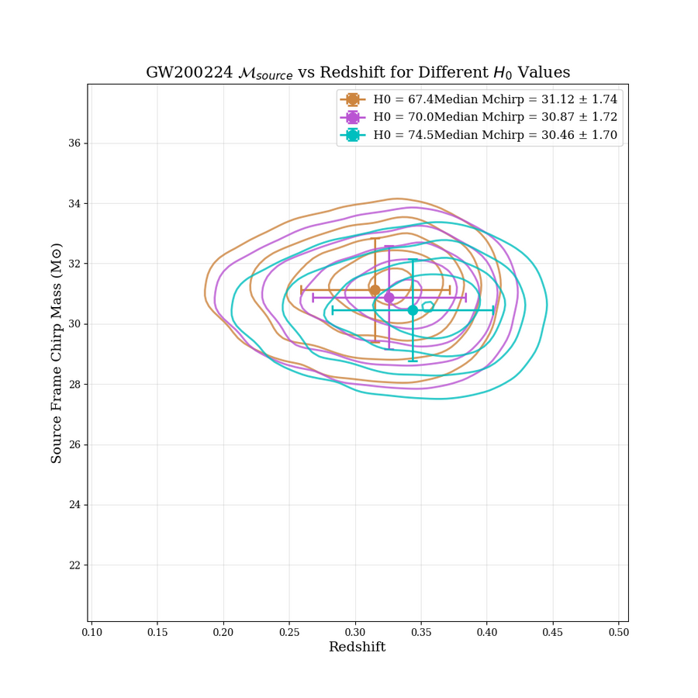
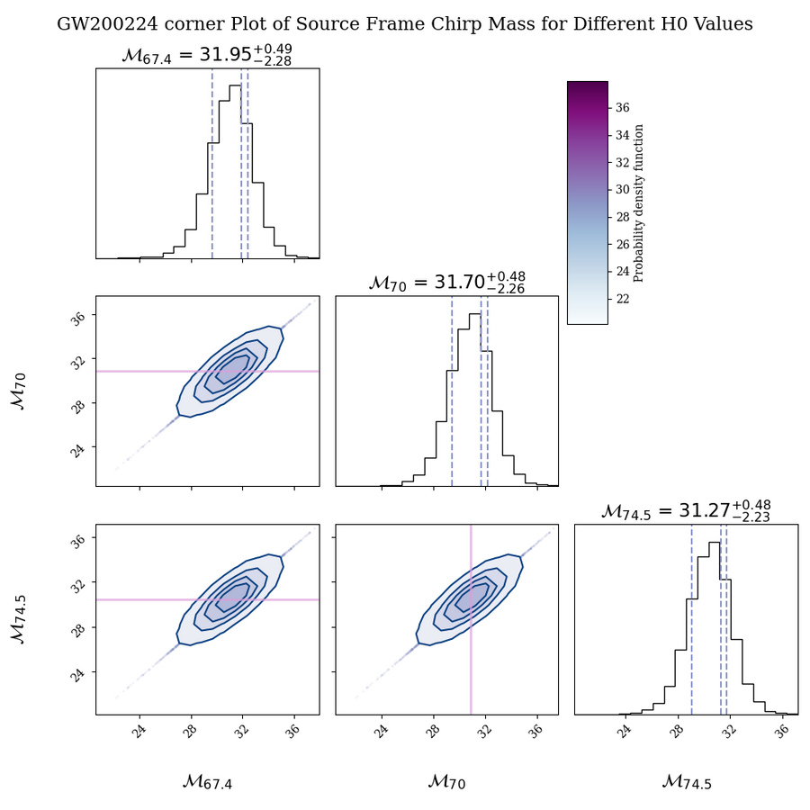
Results
GW200224
14

Slide 18
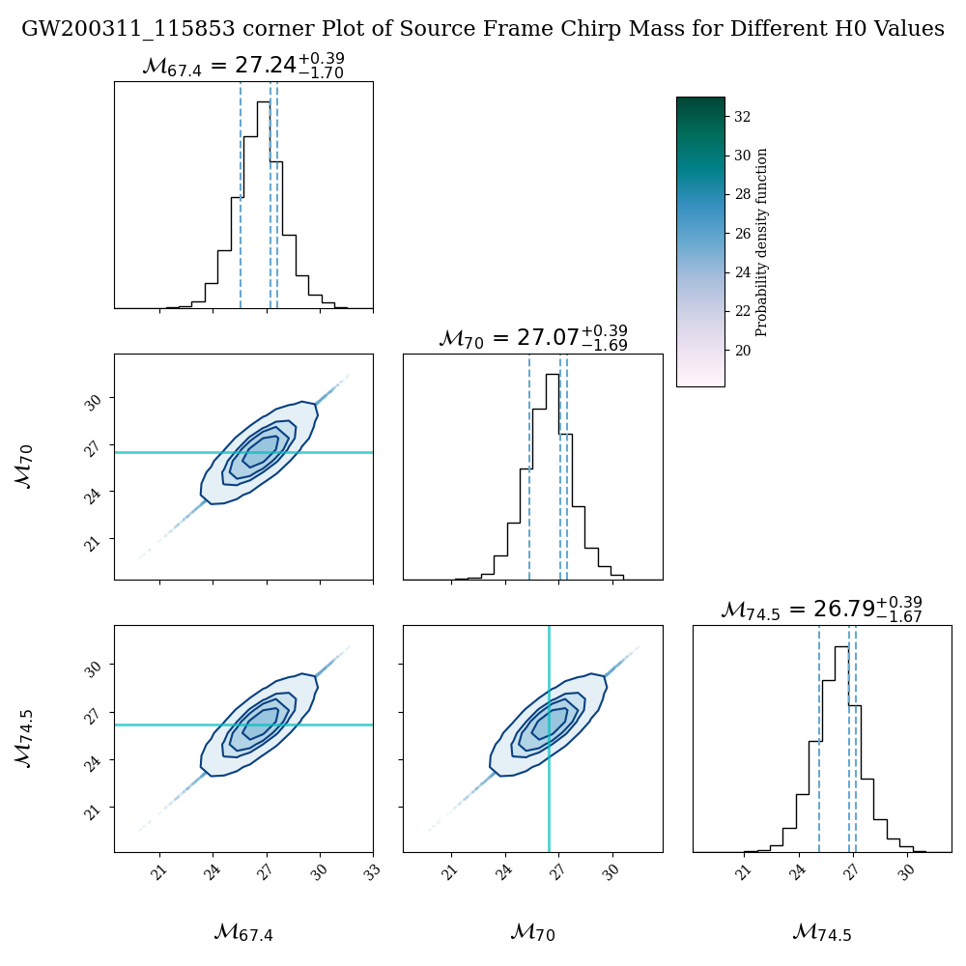
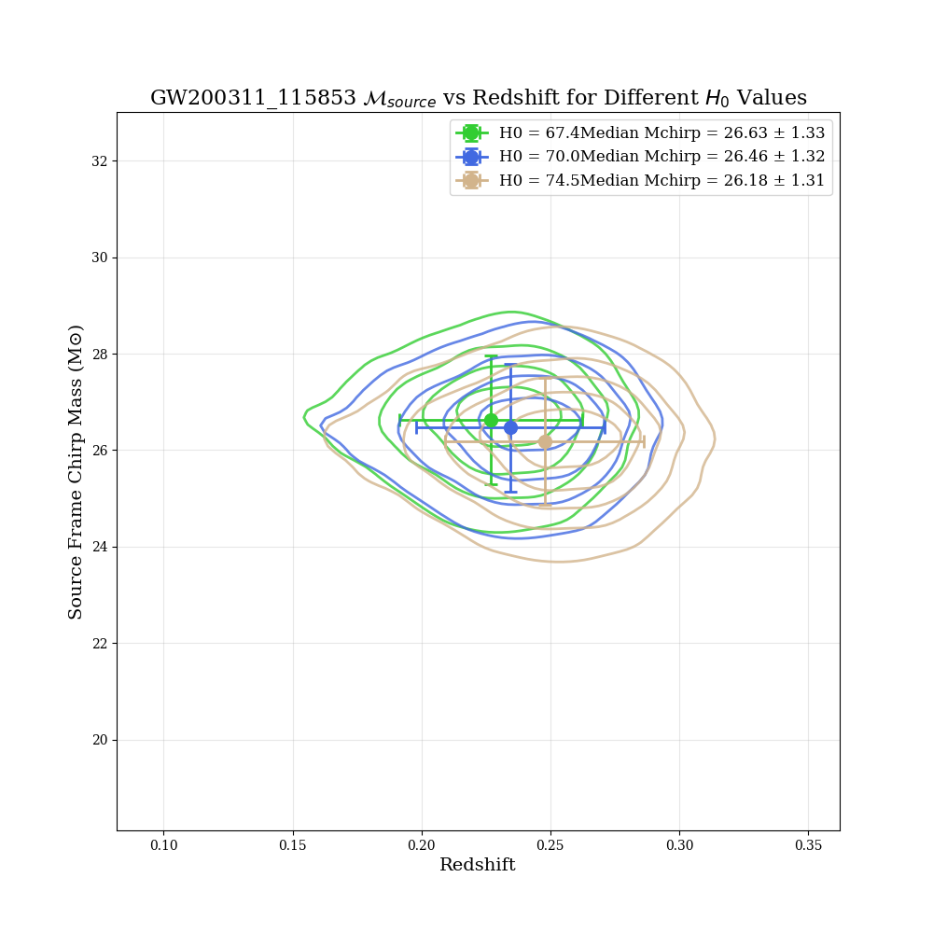
GW200311
15

Slide 19
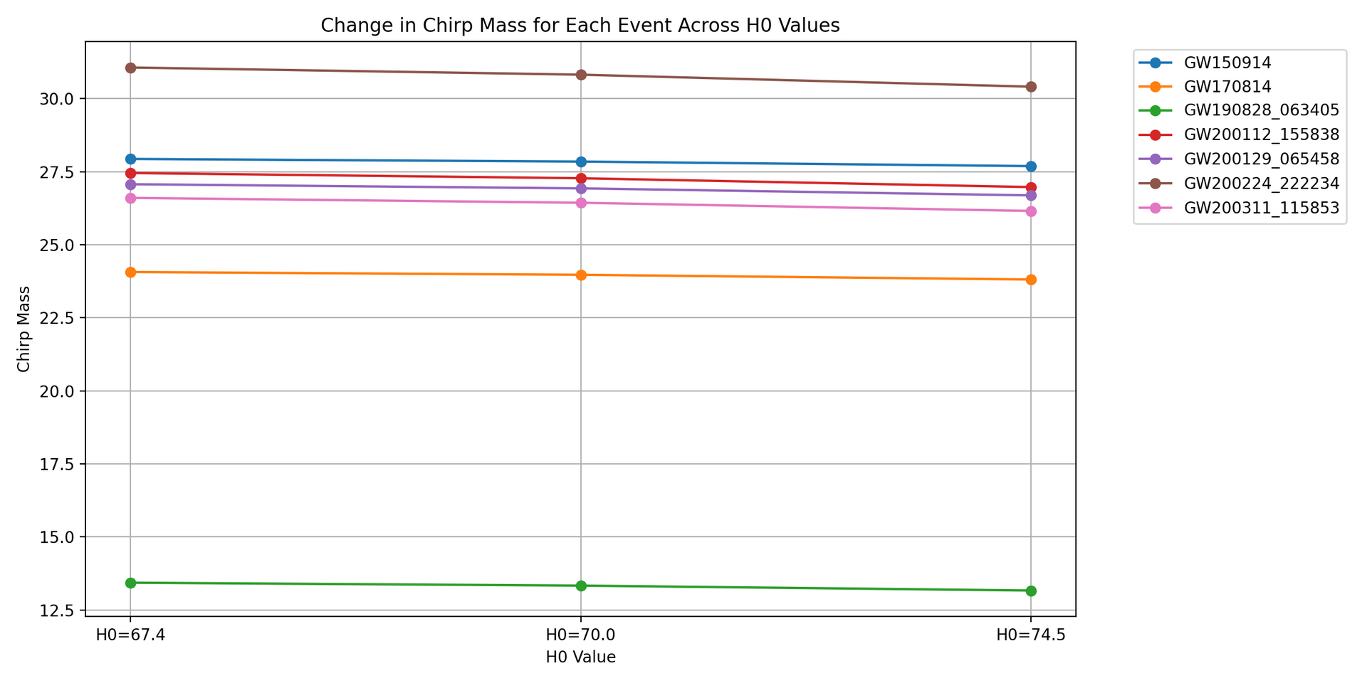
Is this diffrence significant?
Thynk Unlimited
Discussion
16

Slide 20
Is this diffrence significant?
A T-test is conducted to assess the difference, and it was found to be a relatively significant difference
: • H0=67.4 vs H0=70.0: t-statistic = 6.8040, p-value = 0.0005
• H0=70.0 vs H0=74.5: t-statistic = 6.8877, p-value = 0.0005
• H0=67.4 vs H0=74.5: t-statistic = 6.8564, p-value = 0.0005
However, Cohen’s d effect size (H0 = 67.4vsH0 =74.5) : 0.0696 indicates that
the magnitude of the effect is small.
Hence, we cannot draw a conclusion about
the chirp mass based on the current state of this study...
Discussion
17

Slide 21


Thynk Unlimited
Limitations of the Study
The study analysis focused on low-redshift events z and did not include the effects of high-redshift mergers. So far, detected gravitational wave CBCs are confined to a limited redshift range of 0.1 ≤ z ≤ 1.2.
the posterior data used in this study were reweighed, and a previous prior was assumed to have a uniform merging rate (B. P. Abbott et al., 2019)
which introduces a "statistical bias" in our results.
The results are subject to the inevitable uncertainty of the luminosity distance dL values inferred from the GW signals, which lie within the degeneracy of the orbital inclination during the Inspiral phase
Page 09
| Thesis Defense Presentation
Discussion
18

Slide 22
Future work
The next step will be to consider gravitational wave population events; future hypotheses can be well addressed.
Studying other parameters have the potential to study the effects of cosmology, such as matter density Ωm
19

Slide 23
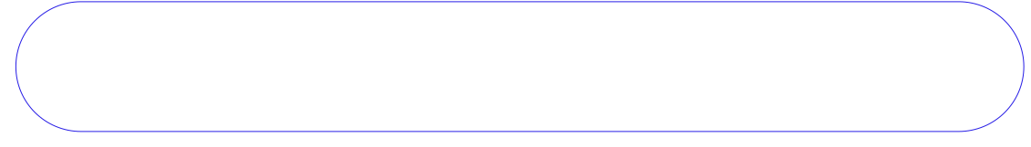
Thynk Unlimited
Conclusion
The degeneracy between estimating the redshift and the chirp mass of the source was observed in this study, where most of the gravitational waves lack electromagnetic observations.
It observed that gravitational waves(GWs) are not sensitive enough to pin down the Hubble constant at the current stage of observations.
Future gravitational wave observatories promise to provide much-enhanced sky localization (such as the Einstein Telescope in the next few years) and, therefore, more electromagnetic counterparts that will offer improved cosmological inference using gravitational waves (GWs) with even higher redshifts, serving as a more robust tool to probe cosmology
Page 08
| Thesis Defense Presentation
20

